Slide 1
INTELLIFALLGUARD
ANANDAKRISHNAN A (21BCE1682)
MR NIRANJAN (21BCE1988)
GUIDE NAME: Dr. V. Premanand (53078)
SCHOOL OF COMPUTER SCIENCE AND ENGINEERING
November,2024

Slide 2
INTRODUCTION
The increasing global aging population presents a growing concern for the safety and well-being of elderly individuals. Falls are a significant health risk for older adults, often leading to severe injuries, hospitalization, and reduced quality of life. Traditional fall detection systems often rely on wearable devices or pressure sensors, which can be inconvenient and prone to false alarms. To address these limitations, this project proposes an innovative IoT-based fall detection system that leverages the power of computer vision and machine learning. By integrating a YOLOv5 object detection model with an MPU6050 sensor and an ESP8266 Wi-Fi module, the system aims to accurately detect falls in real-time and trigger immediate alerts to caregivers or emergency services. Additionally, the system incorporates a patient health monitoring component, utilizing a variety of sensors to track vital parameters such as heart rate, blood oxygen levels, and body temperature. This comprehensive approach ensures that elderly individuals receive timely assistance in case of a fall and continuous monitoring of their overall health status. By combining advanced technology with user-friendly design, this project seeks to empower older adults to live independently with peace of mind, while providing their caregivers with essential tools to safeguard their well-being.

Slide 3
PROBLEM STATEMENT
Existing fall detection systems often face challenges related to accuracy, reliability, and user convenience. Many systems rely on wearable devices or pressure sensors, which can be intrusive and uncomfortable for elderly individuals. Additionally, these systems may struggle to distinguish between actual falls and other movements, leading to false alarms and unnecessary interventions. To address these limitations, there is a need for a robust and non-intrusive fall detection system that can accurately identify falls in real-time and trigger appropriate responses.

Slide 4
RESEARCH OBJECTIVE
The primary objective of this research is to develop an IoT-based fall detection system that combines the strengths of computer vision, machine learning, and sensor technology to accurately detect falls among elderly individuals. The system should be capable of:
Accurate fall detection: Employing a YOLOV5 object detection model to identify human falls from video streams.
Real-time monitoring: Utilizing video module and MPU6050 sensor to capture acceleration and gyroscope data for additional fall detection.
Reliable alerts: Sending timely notifications to caregivers or emergency services via SMS and email.
Comprehensive health monitoring: Tracking vital parameters such as heart rate, blood oxygen levels, and body temperature using an ESP8266-based sensor module.
User-friendly interface: Providing a web-based platform to visualize health data and fall detection events.

Slide 5
PROPOSED SYSTEM
Introduction
The proposed IoT-based fall detection and health monitoring system integrates hardware and software components to provide a comprehensive solution for elderly care. The system comprises a camera module, an MPU6050 sensor, an ESP8266 Wi-Fi module, and a cloud-based server (implementing YOLO model and alert system and the sensor as simulation model). The camera module captures video footage of the elderly individual, while the MPU6050 sensor collects acceleration and gyroscope data. The ESP8266 module transmits the data to the cloud server, where it is processed using the YOLOv5 model to detect falls. In addition, the ESP8266 module can be configured to monitor various health parameters, such as heart rate, blood oxygen levels, and body temperature, using additional sensors. The cloud server analyzes the data, generates alerts in case of a fall or abnormal health readings, and provides a web-based interface for remote monitoring and data visualization.

Slide 6
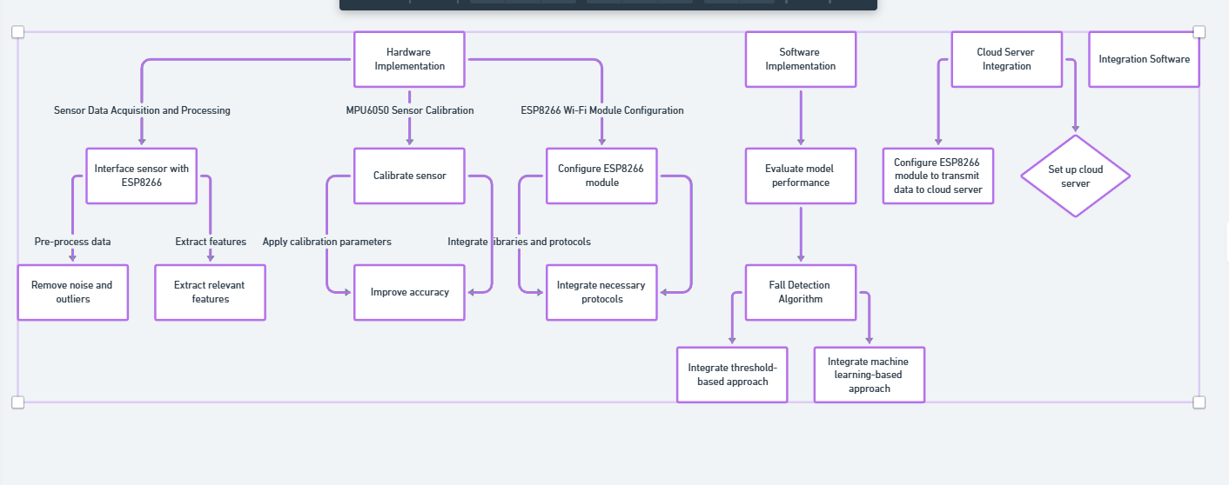
FLOW CHARTS AND SYSTEM DIAGRAM

Slide 7
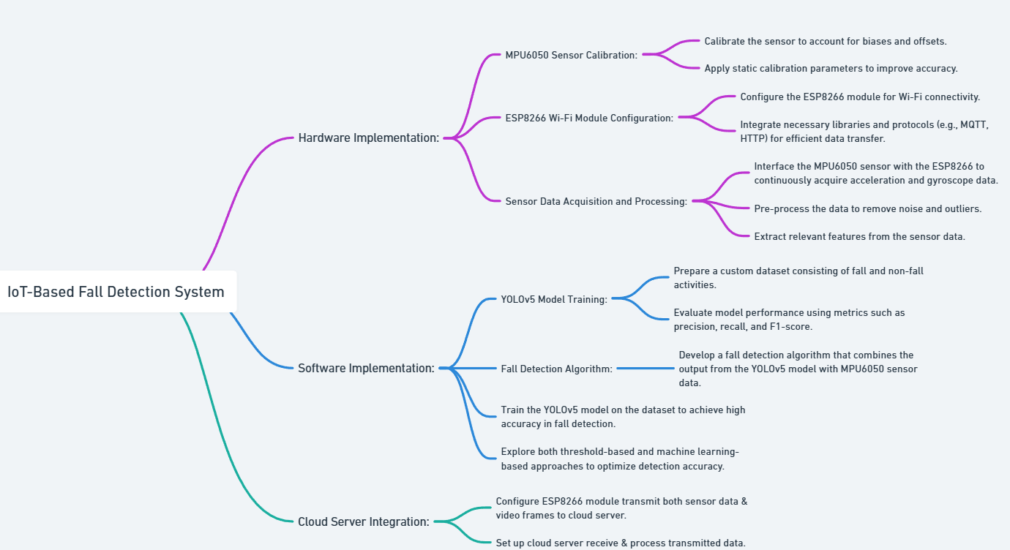
FLOW CHART DIAGRAM

Slide 8
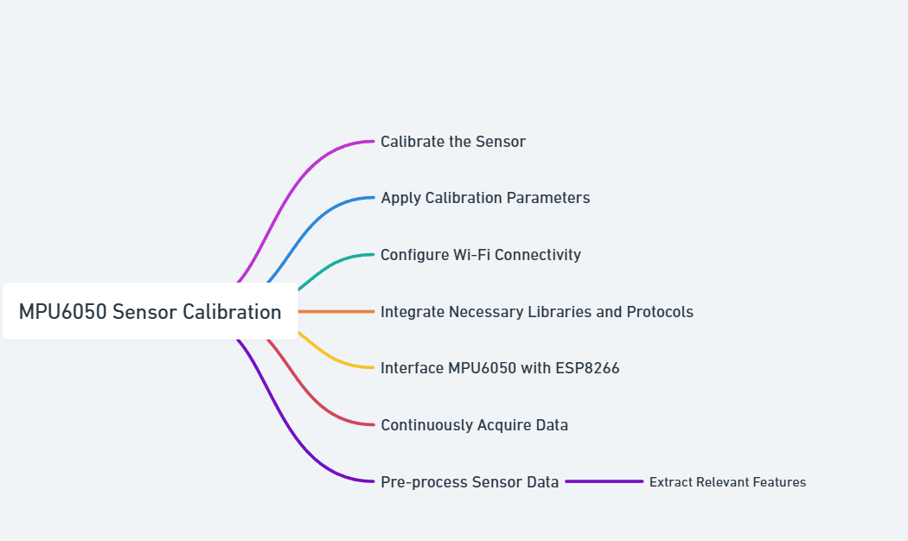
MPU6050 SENSOR DIAGRAM

Slide 9
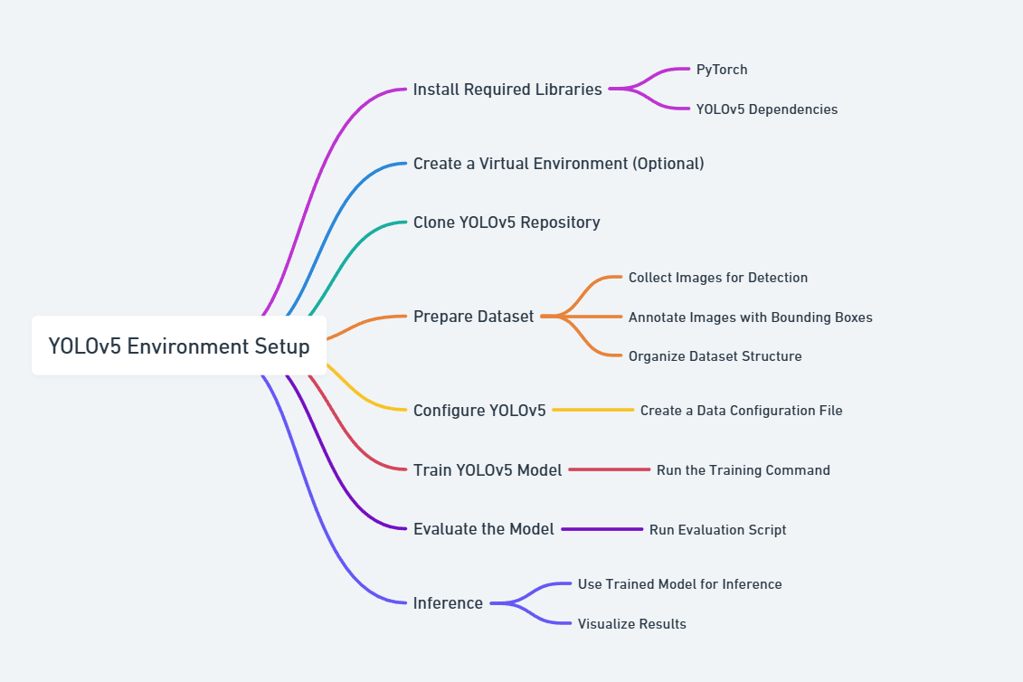
ML MODEL FLOWCHART DIAGRAM

Slide 10
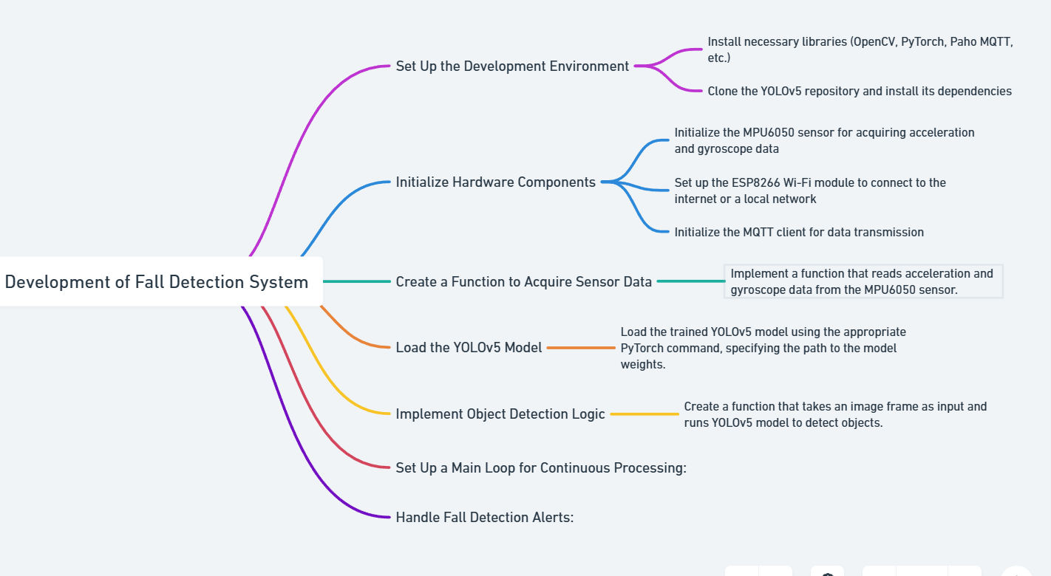
WORK FLOW DIAGRAM

Slide 11
List of Modules
Camera Module: Captures video footage of the elderly individual.
YOLOv5 Model: Detects falls from video frames.
MPU6050 Sensor: Measures acceleration and gyroscope data. (Simulation)
ESP8266 Wi-Fi Module: Transmits data to the cloud server.
Cloud Server: Processes data, generates alerts, and provides a web interface.
User Interface: To provide analytics and fall detection data on screen for user.
1.Camera Module:
The camera module is responsible for capturing real-time video footage of the elderly individual. The captured video frames are then processed by the YOLOv5 model to detect falls. Camera module has multiple screens and helps in detecting the fall by providing inputs for our model.

Slide 12
2.MPU6050 Sensor:
The MPU6050 sensor is a versatile inertial measurement unit (IMU) that measures acceleration and angular velocity along three axes. By analyzing the changes in acceleration and angular velocity patterns, the sensor can detect sudden movements associated with falls.
3.YOLOv5 Model:
YOLOv5 is a state-of-the-art object detection model that is highly efficient and accurate. It is trained on a large dataset of images and videos containing human falls and other activities. The model analyzes each video frame and identifies objects of interest, such as humans, and their bounding boxes. By analyzing the position, size, and movement of the detected human objects, the model can determine if a fall has occurred.
4.ESP8266 Wi-Fi Module:
The ESP8266 is a low-cost Wi-Fi module that enables wireless communication between the sensor modules and the cloud server. It transmits the captured video frames, sensor data, and health parameter readings to the cloud for further processing and analysis.

Slide 13
4.Cloud Server:
The cloud server is the central hub of the system, responsible for data processing, analysis, and alert generation. It receives the video frames, sensor data, and health parameter readings from the ESP8266 module. The server then processes the video frames using the YOLOv5 model to detect falls. If a fall is detected, the server sends alerts to caregivers or emergency services via SMS or email. Additionally, the server stores the data for long-term analysis and provides a web-based interface for remote monitoring and data visualization.
5.User Interface:
The interface will consist of several key components, including a dashboard to display real-time sensor data and fall detection status, a camera feed to monitor the user's activity and emergency contacts and health analytics.

Slide 14
IMPLEMENTATION WITH RESULTS
User Interface
React UI: A user-friendly React UI has been developed to display real-time camera feeds, fall detection status, health parameters, and emergency contact information.
Camera Card: A card is designed to display multiple camera feeds, including a local PC camera and remote IP cameras.
Fall Detection Status Card: A card displays the current fall detection status, indicating whether a fall has been detected or not.
Health Parameter Card: A card displays real-time health parameters, such as heart rate, blood oxygen levels, temperature, and humidity.
Emergency Contact Card: A card displays a list of emergency contacts with their phone numbers.

Slide 15
ANALYSIS OF HEARTBEAT WHEN ONE FALLS
When someone experiences an immediate fall, the body's response can vary depending on the individual and the circumstances of the fall. In general, during a fall, the body's sympathetic nervous system is activated, leading to an increase in heart rate in order to maintain blood flow to vital organs and muscles. This is known as the "fight or flight" response. Therefore, in most cases, when someone has an immediate fall, their heart rate is likely to increase. This is a normal physiological response to stress or sudden physical exertion. However, it is important to note that individual variations can occur, and some people may experience a decrease in heart rate due to other factors such as underlying medical conditions or medications. In such situations, it is important to monitor the individual closely and seek medical attention if there are any concerning symptoms or if the heart rate remains elevated or decreased for an extended period of time.
Sympathetic nervous systemAlso known as the "fight or flight" system, this system prepares the body for danger by increasing heart rate, blood pressure, and alertness, and inhibiting digestion. Parasympathetic nervous systemAlso known as the "rest and digest" system, this system returns the body to normal after a dangerous situation by decreasing heart rate, constricting the pupil, and increasing gut motility.

Slide 16
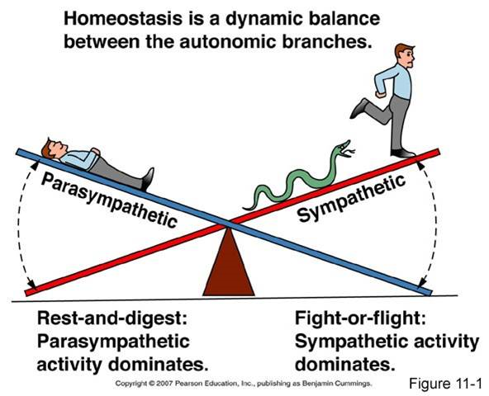
We have also developed a Random Forest-based /SVM fall detection model using synthetic data that simulates heart rate and SpO2 measurements. Here's what we discovered:
Synthetic Data:
Normal activities: Heart rate ~ 70 bpm, SpO2 ~ 98%.
Fall scenarios: Elevated heart rate ~ 90 bpm, slightly lower SpO2 ~ 95%.
Model Performance:
The Random Forest model accurately distinguishes between "fall" and "no fall" based on these features.
Visualization:
Scatter plots reveal clear separations between fall and no-fall cases, aiding model interpretability.
Real-Time Application:
The model can handle live predictions, making it feasible for wearable devices or medical applications.

Slide 17
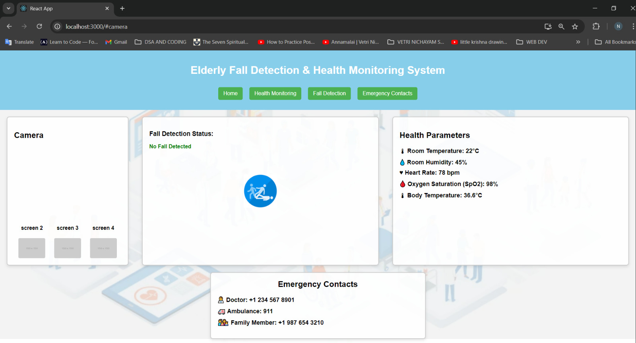
USER INTERFACE SCREENSHOT

Slide 18
Fall Detection Algorithm
YOLOv5: The YOLOv5 object detection model is employed to detect human figures in video frames.
Fall detection dataset: we had gathered images from various sources and created our own custom fall detection dataset with two directories of images and labels. Images directories consist of two subdirectories train (374 images) which is used for training and Val (111 images) for validation. Labels directory consists of two subdirectories train and Val here in this directory we have text files with labels of that particular image.
Fall Detection Logic: A set of rules is defined to identify fall patterns based on human pose and motion.
Threshold-Based Detection: A threshold value is set for acceleration and gyroscope data to trigger a fall alarm.

Slide 19
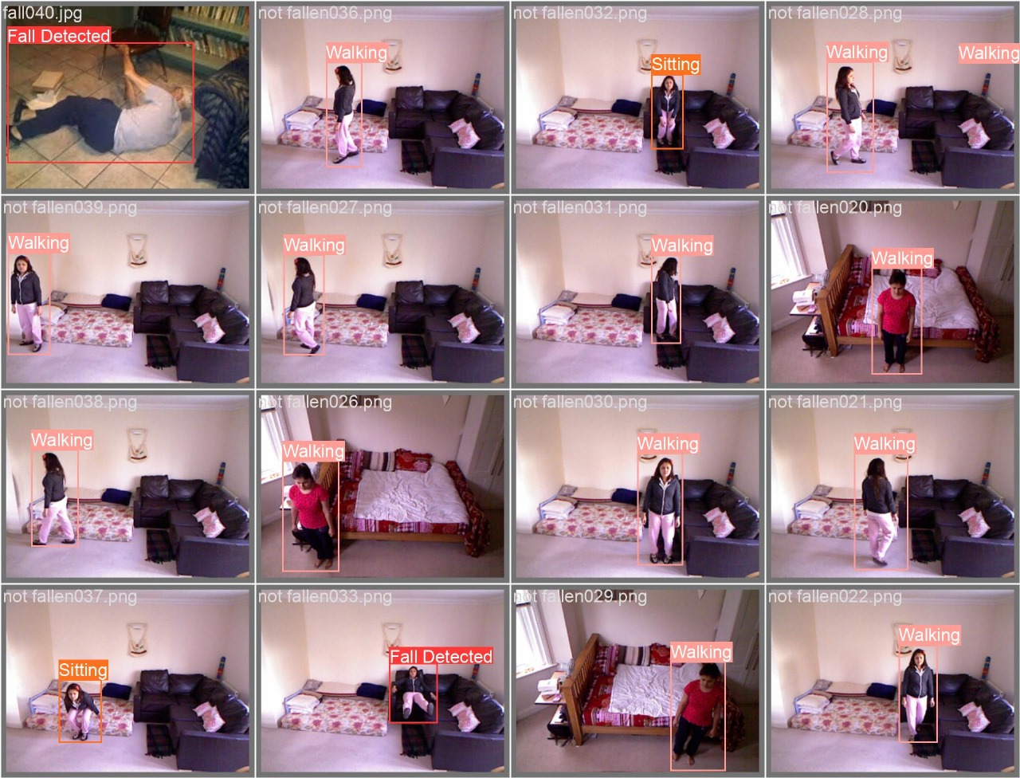
FALL DETECTION SCREENSHOTS

Slide 20
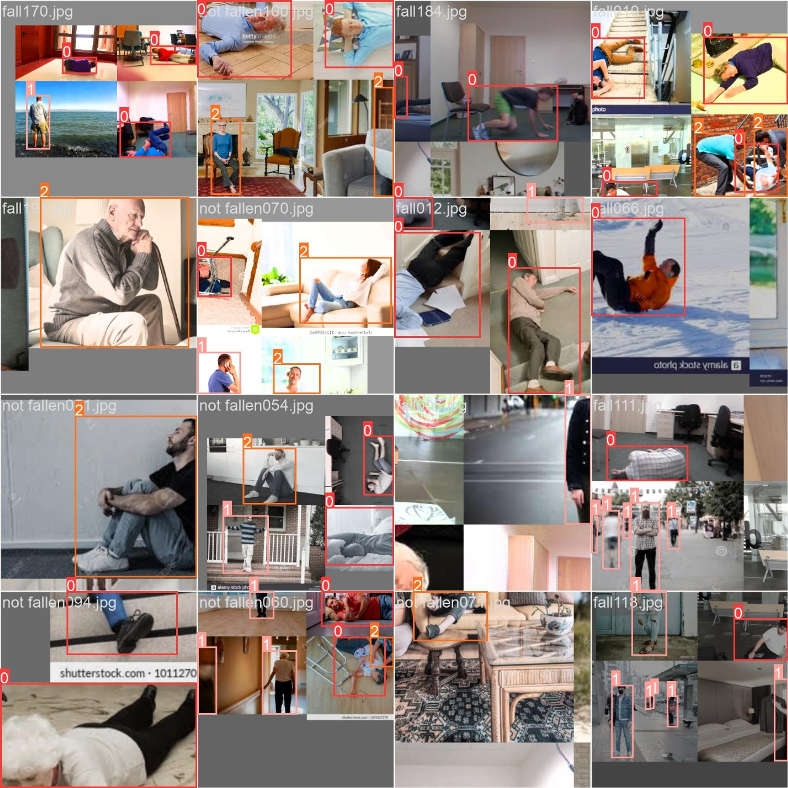
FALL DETECTION SCREENSHOTS

Slide 21
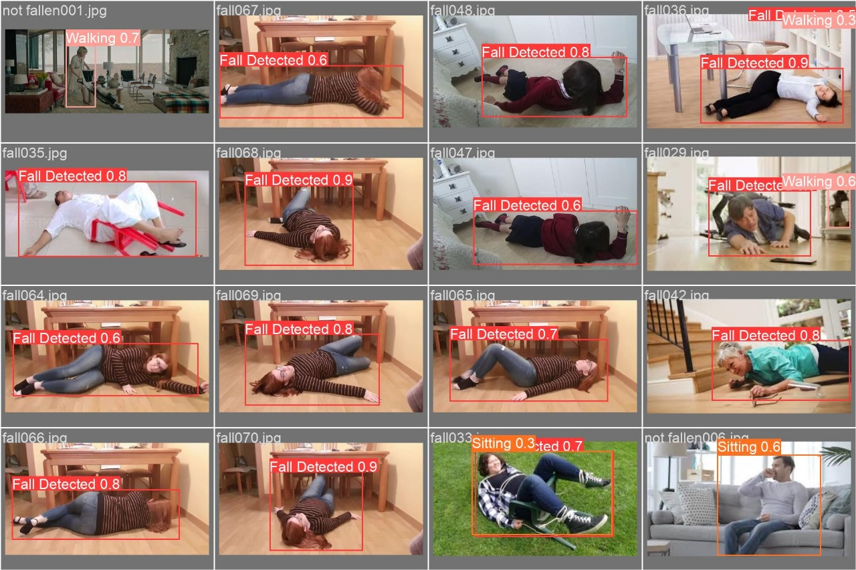
FALL DETECTION SCREENSHOTS

Slide 22
Fall Detection and Health Parameter Monitoring
Sensor Integration: The ESP8266 module is used to interface with various sensors, including temperature, humidity, heart rate, and blood oxygen level sensors.
Data Visualization: The web application displays the collected health parameter data in a clear and concise manner.

Slide 23
Algorithm-Specific Thresholds:
Different algorithms use various thresholds and combinations of features to detect falls. Some common approaches include:
Threshold-Based Methods:
Set specific thresholds for acceleration and gyroscope values.
If these thresholds are exceeded for a certain duration, a fall is detected.
Machine Learning-Based Methods:
Train a machine learning model on a dataset of fall and non-fall activities.
The model learns to identify patterns in the sensor data that are characteristic of falls.
Hybrid Approaches:
Combine threshold-based and machine learning techniques to improve accuracy and robustness.

Slide 24
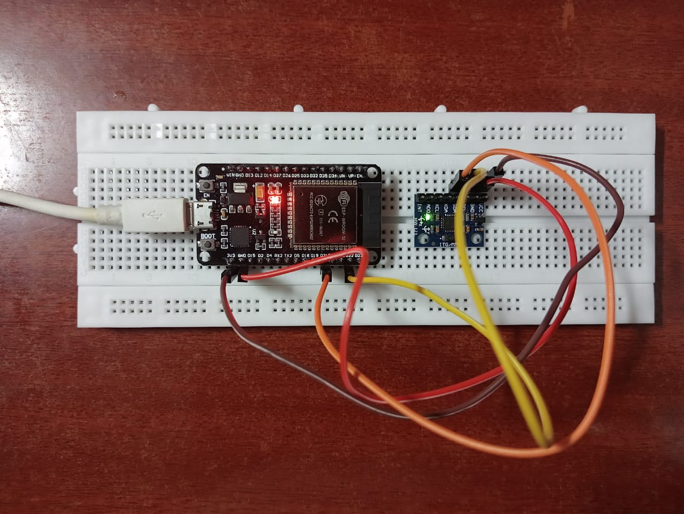
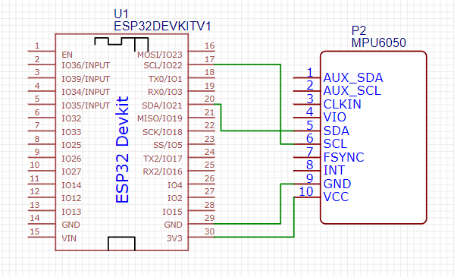
FALL DETECTION IOT PART
CIRCUIT DIAGRAM

Slide 25
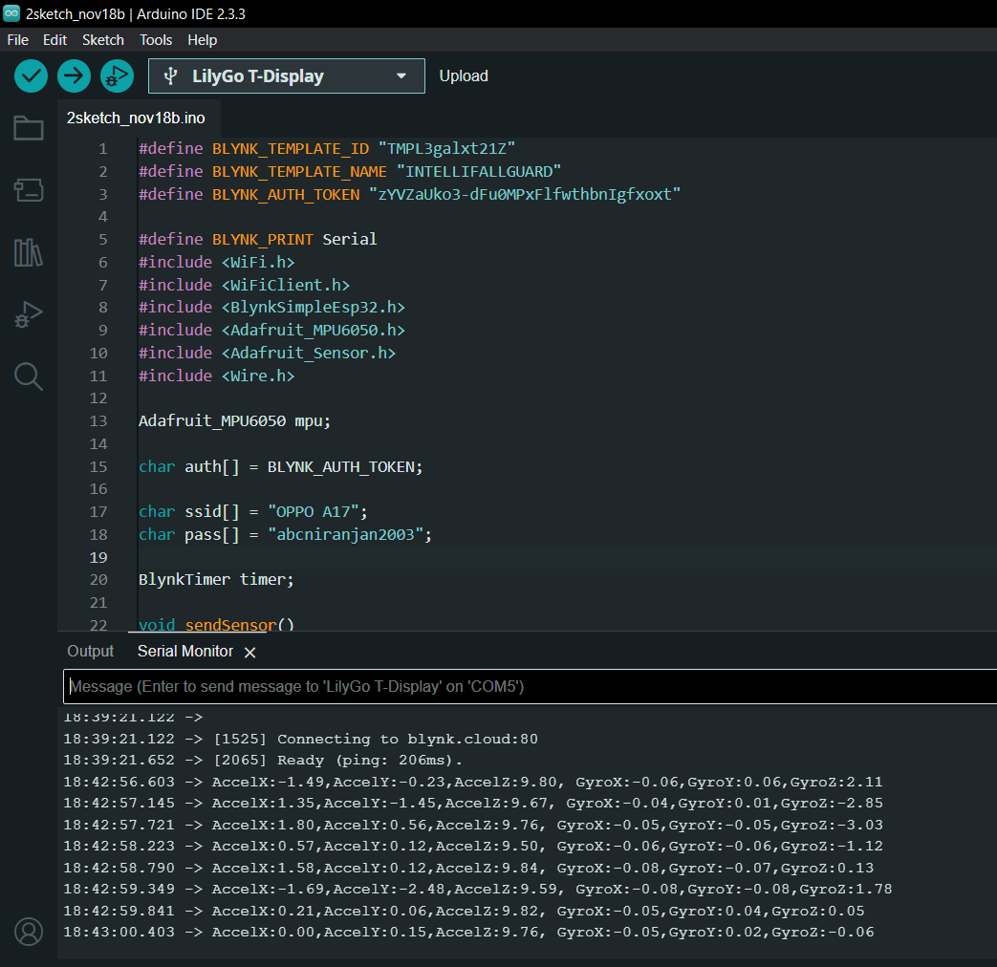
ARDUINO IDE SETUP

Slide 26
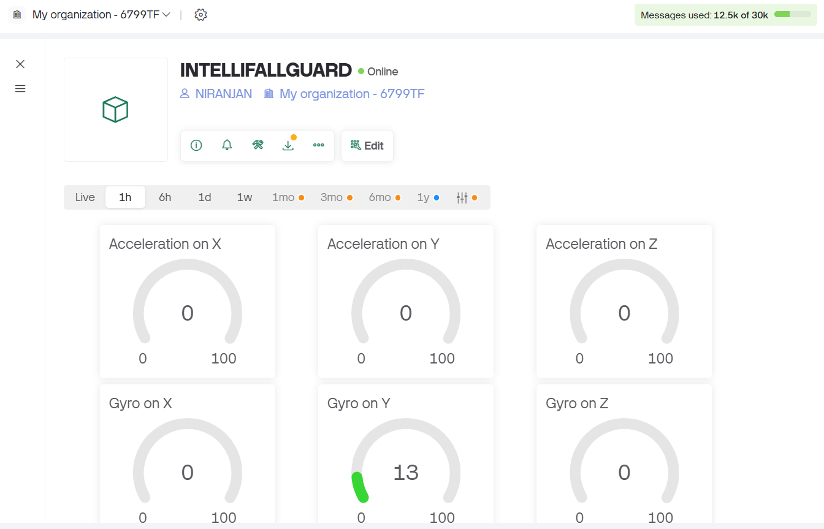
IOT WEBDASHBOARD

Slide 27
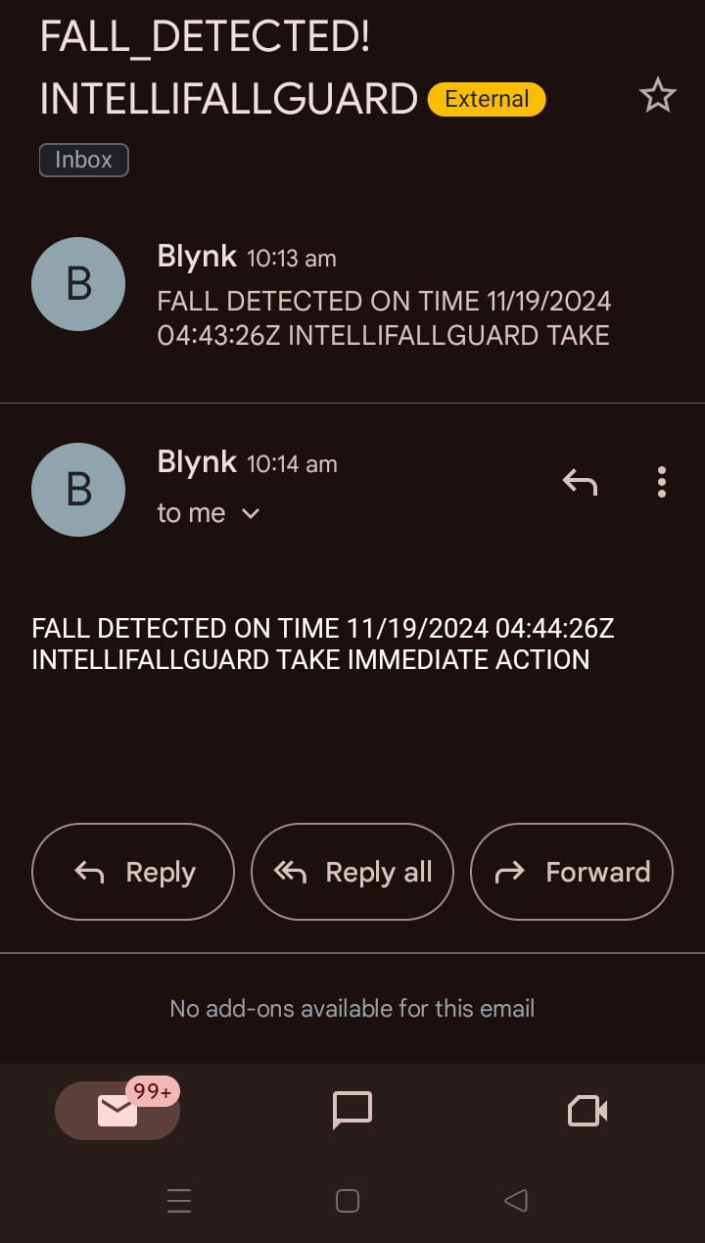
FALL DETECTED MAIL

Slide 28
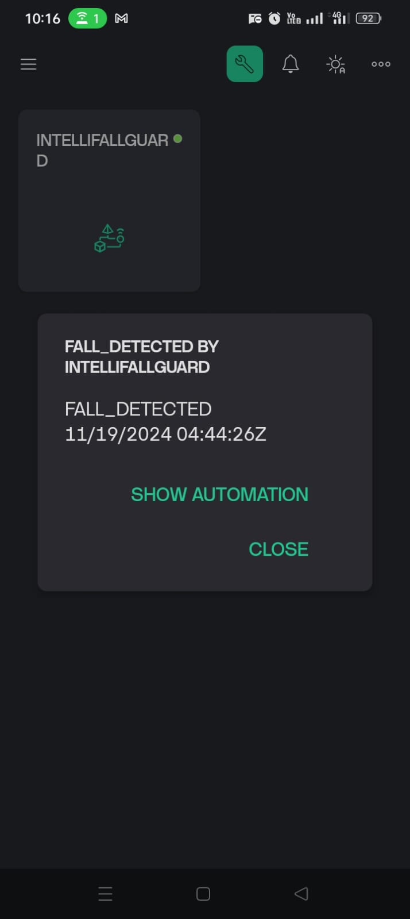
FALL DETECTED MOBILE APP NOTIFICATION FOR
CARETAKER

Slide 29
Results and Discussion
Fall Detection Accuracy: The YOLOv5 model achieved high accuracy in detecting falls, with a low false positive rate.
Health Parameter Monitoring Accuracy: The sensor readings were accurate and reliable, providing valuable insights into the elderly person's health status.
User Interface Usability: The web application provided an intuitive and user-friendly interface for monitoring and controlling the system.

Slide 30
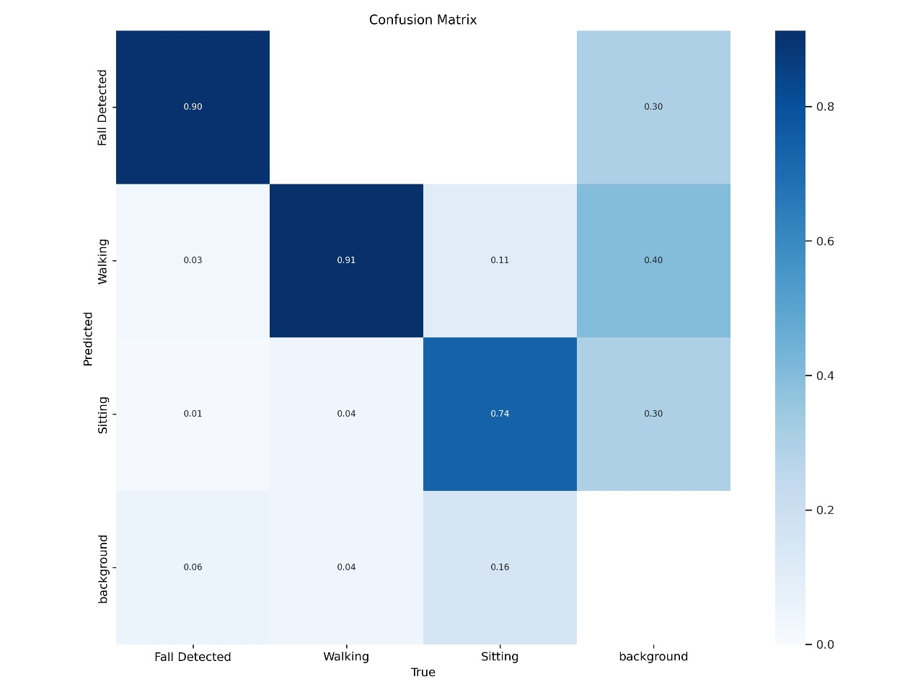
OUTPUT SCREENSHOTS FOR ML MODEL

Slide 31
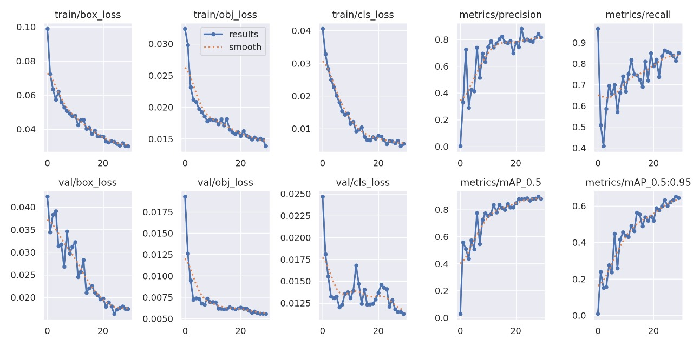
OUTPUT SCREENSHOTS

Slide 32
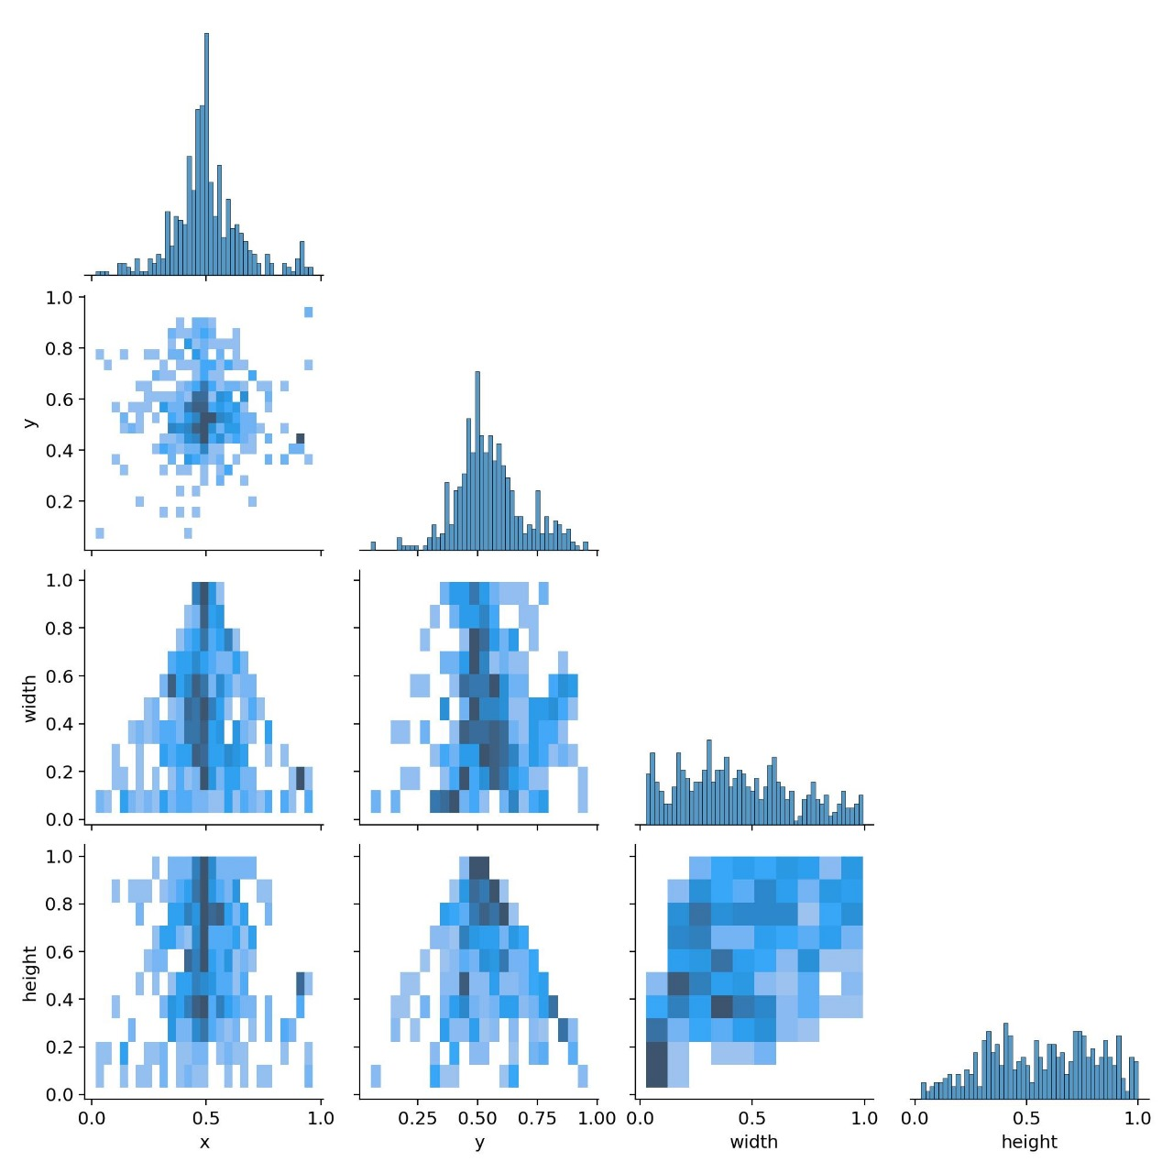
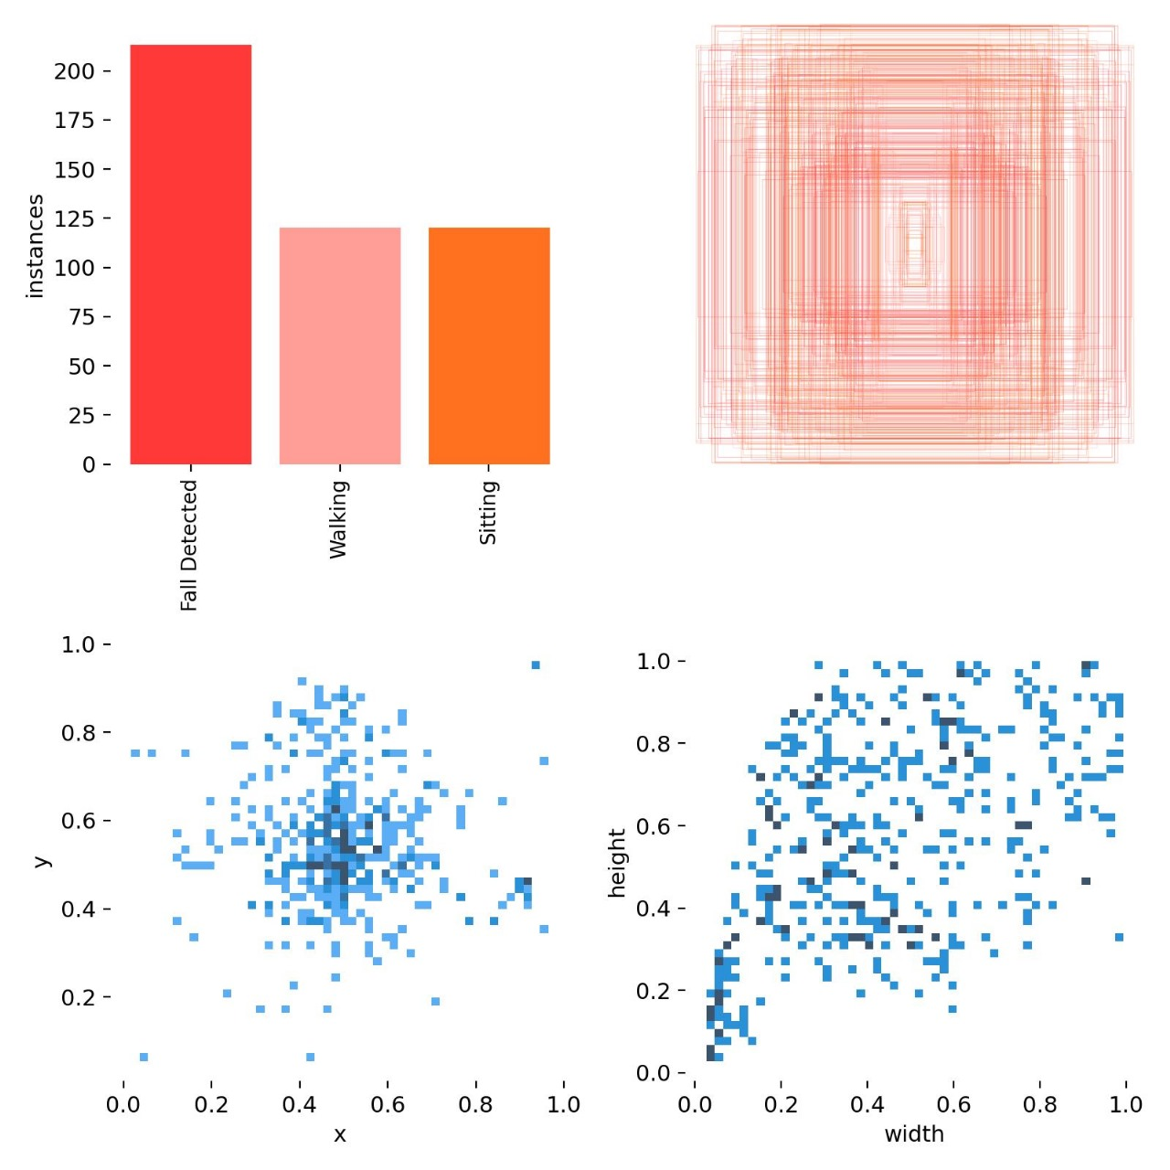
OUTPUT SCREENSHOTS

Slide 33
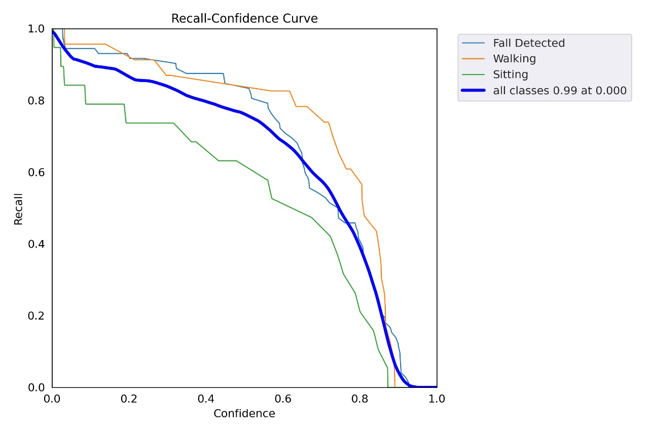
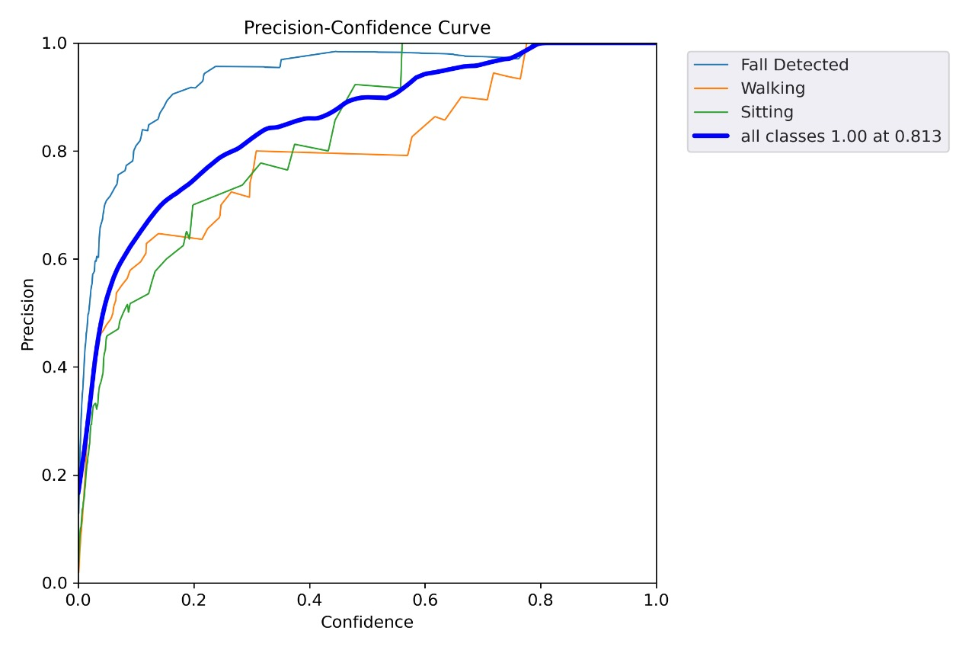
OUTPUT SCREENSHOTS

Slide 34
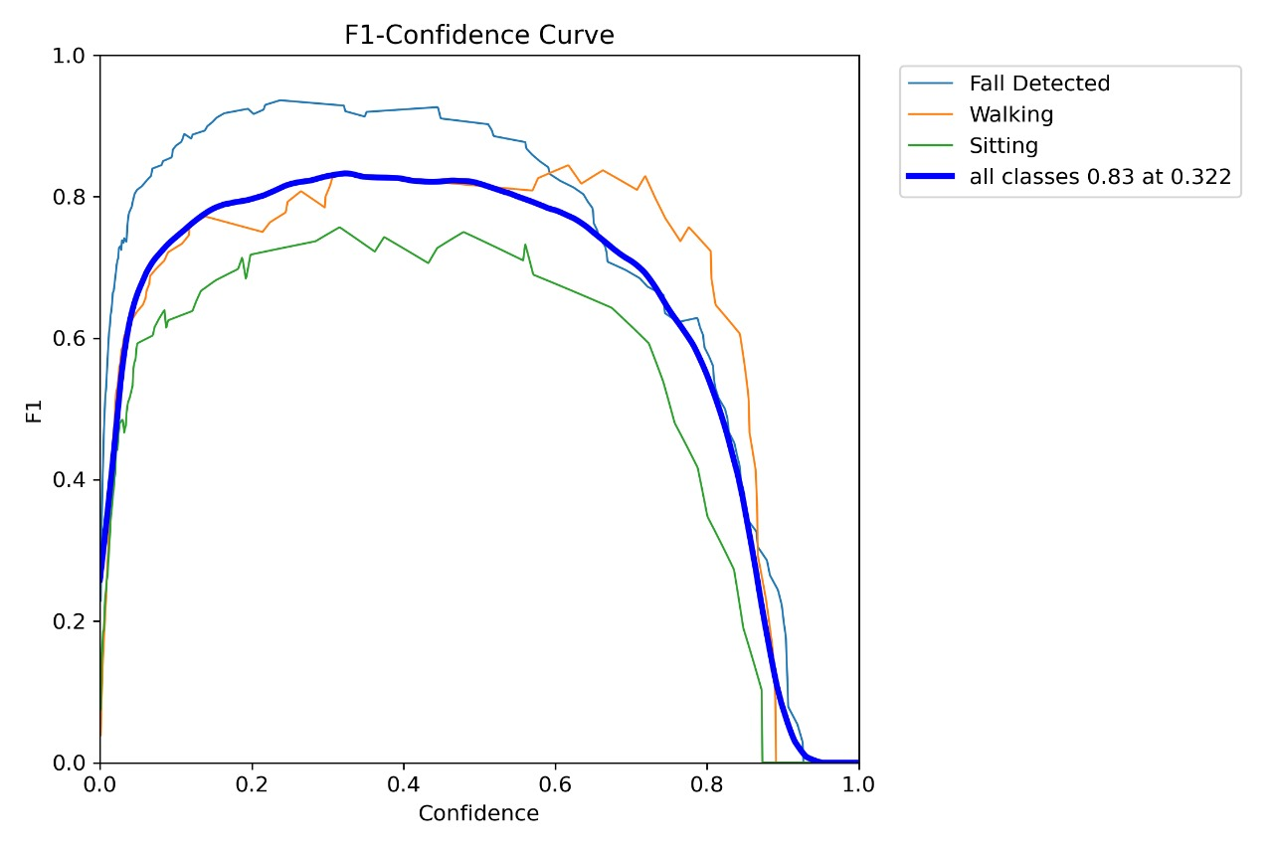
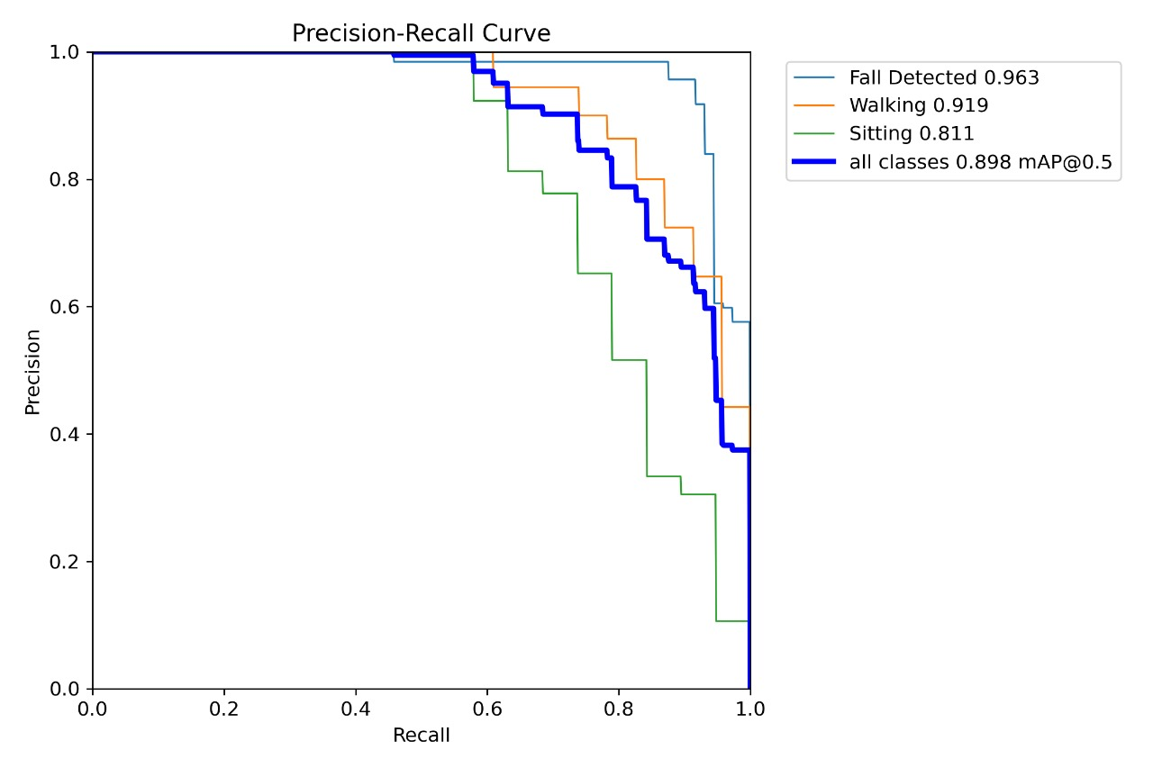
OUTPUT SCREENSHOTS

Slide 35
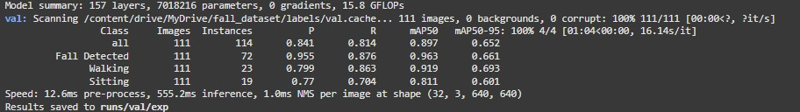
OUTPUT SCREENSHOT
MODEL SUMMARY

Slide 36
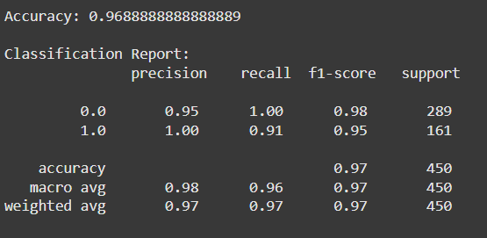
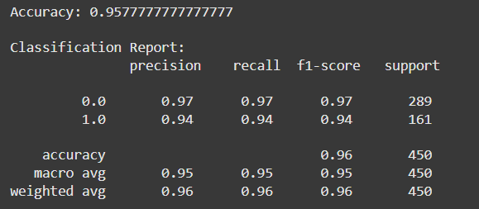
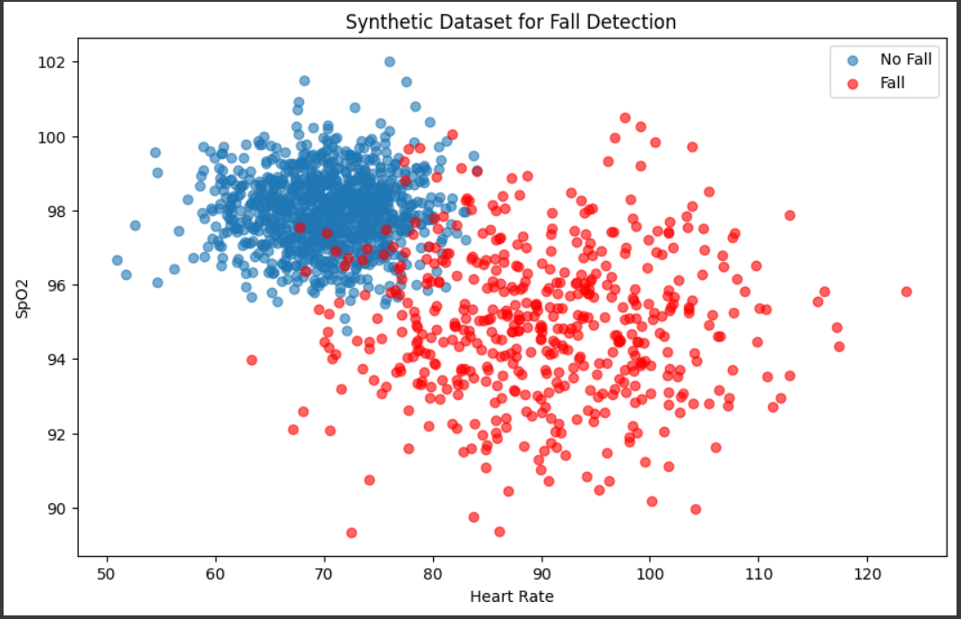
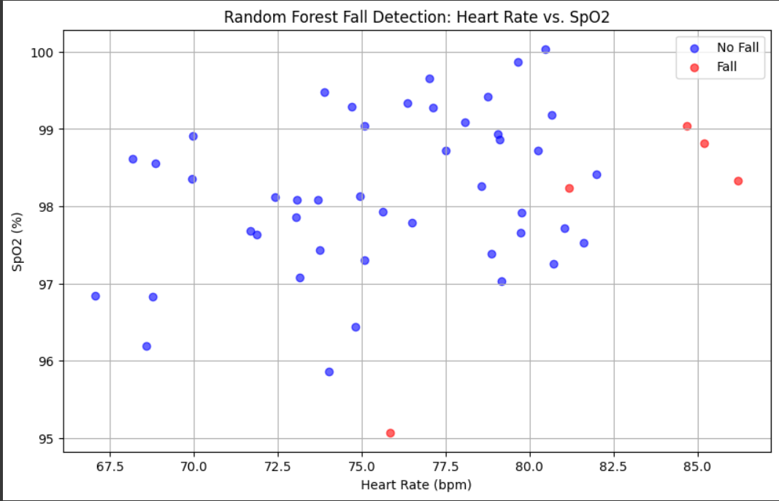
SVM RANDOMFOREST
Results of SVM and Random forest based fall detection:

Slide 37
CONCLUSION
IntelliFallGuard, a dual-mode fall detection system leveraging both sensor data and machine learning, offers a promising solution for elderly care. By combining hardware and software approaches, it enables accurate and timely fall detection, even in complex environments. The system's non-intrusive nature and scalability make it suitable for both home and hospital settings. The integration of machine learning enhances detection accuracy and reduces false alarms. When a fall is detected, immediate alerts are sent to designated caregivers or healthcare facilities, ensuring prompt assistance. IntelliFallGuard's innovative architecture and efficient implementation contribute to its superior performance and adaptability, making it a valuable tool for promoting safety and independence among the elderly population.

Slide 38
Future Work:
Model Improvement:
Hybrid models combining multiple techniques for enhanced accuracy.
Severity classification for prioritized response.
Algorithm Optimization:
Explore advanced CNN algorithms and combinations for better results.
Develop AI models for sensor-only data for faster and more robust predictions.
Data Enhancement:
Expand the training dataset to include diverse fall scenarios.
Optimize data augmentation, fine-tuning, and hyperparameter tuning.
Edge Computing Integration:
Implement edge computing for real-time processing and reduced latency.
Deploy lightweight models for offline fall detection and health monitoring.
Sensor Integration:
Incorporate additional sensors for improved accuracy and versatility.
Energy Efficiency and Battery:
Optimize hardware and software for efficient power consumption.
Explore energy-efficient sensor technologies and battery management strategies.

Slide 39
Future Perspective:
Large-scale Production: Manufacture and distribute the software and wearable hardware.
Wide-scale Deployment: Utilize the system in hospitals, homes, and various care settings.
Multiple Versions: Offer different versions tailored to specific needs and preferences.

Slide 40
RESEARCH PAPER STATUS
https://docs.google.com/document/d/11iE301pe6tBQKCFqKmpUeFO5Yn-3DbSyGVrreLV8vws/edit?tab=t.0

Slide 41
REFERENCES
https://whimsical.com/development-of-fall-detection-system-Ad1ZMZWY1eWuYXz9PV6KLo
https://kaggle.com/
https://www.kaggle.com/datasets/uttejkumarkandagatla/fall-detection-dataset/data
https://www.ieee.org/
https://www.sciencedirect.com/
https://www.researchgate.net/

